Slide 1
Healthcare Data Analysis: Understanding Patient Demographics and Disease Trends
Srinitha Tirunagari -160122737085
Sarayu Thotakura -160122737086
Vrithika Boggarapu-160122737089

Slide 2

Project Overview:
In this project, we will analyze a dataset containing healthcare records to gain insights into patient demographics, disease prevalence, and treatment patterns. The goal is to uncover meaningful trends that can inform healthcare providers and policymakers for better decision- making and resource allocation.

Slide 3
ABSTRACT
Healthcare data analysis plays a pivotal role in modern medical practices, facilitating informed decision-making and improving patient outcomes. By harnessing advanced analytical techniques, healthcare professionals can derive valuable insights from vast amounts of data generated by patient records, medical imaging, wearable devices, and other sources. These analyses enable practitioners to identify patterns, trends, and correlations that inform personalized treatment plans, predict disease progression, and enhance preventive care strategies. Moreover, healthcare data analysis contributes to the optimization of resource allocation, streamlining administrative processes, and reducing costs within healthcare systems, ultimately fostering more efficient and sustainable delivery of care.
Furthermore, the integration of healthcare data analysis with emerging technologies like artificial intelligence and machine learning holds immense promise for revolutionizing medical practice.

Slide 4






Tools and Technologies:
Python programming language
Data manipulation libraries (e.g.,Pandas)
Data visualization libraries (e.g.,
Matplotlib, Seaborn)
Geographic information systems (GIS) tools for spatial analysis (e.g., ArcGIS, QGIS)
Statistical analysis tools (e.g., SciPy,
StatsModels)

Slide 5

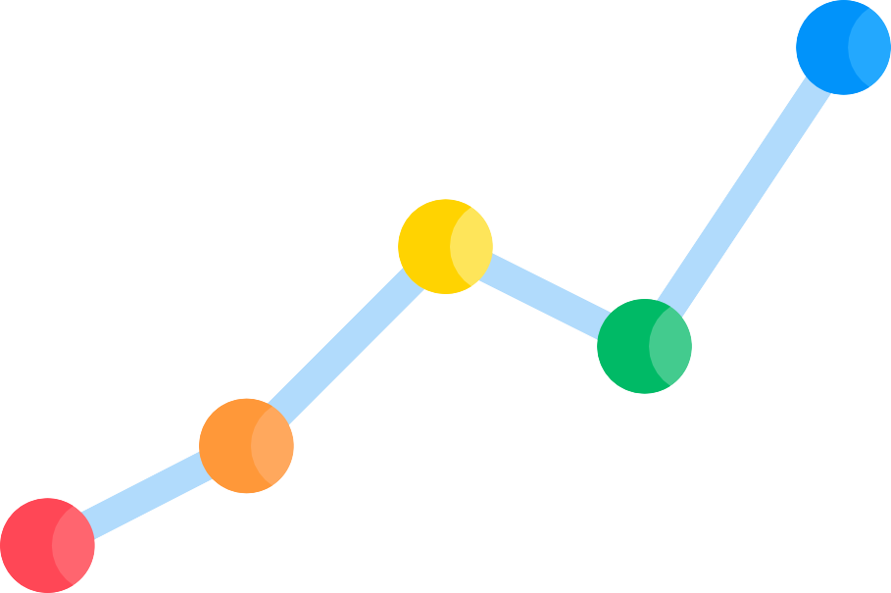
Transforming Healthcare with Data Analysis
Healthcare data analysis transforms medical practice by extracting insights from patient records, medical imaging, and wearable devices. It enables personalized treatment plans tailored to individual needs, improving patient outcomes and care quality. By predicting disease progression, healthcare providers can intervene earlier, enhancing preventive care and mitigating severe health issues. Additionally, it optimizes resource allocation, ensuring efficient use of staff, equipment, and supplies. This optimization reduces operational costs and minimizes waste. Streamlining administrative processes through automation and data-driven decisions reduces manual tasks, allowing healthcare professionals to focus more on patient care. Overall, these advancements foster efficient and sustainable healthcare delivery, ultimately leading to a more effective healthcare system.

Slide 6

Revolutionizing Medicine with AI and Data Analysis
Integrating healthcare data analysis with AI and machine learning revolutionizes medical practice.
Predictive modeling, natural language
processing, and image recognition enhance insights and automate decisions. This innovation improves clinical workflows, advances medical research, and drives breakthroughs in diagnosis and treatment, solidifying data analytics as essential for evidence- based medicine and better patient

Slide 7

Key Steps in Healthcare Data Analysis
Exploratory Data Analysis (EDA): Conducting exploratory data analysis to understand the structure and characteristics of the dataset. Explore variables such as patient age, gender, location, disease diagnoses, treatment modalities, etc.
Demographic Analysis: Analyzing patient demographics to understand the distribution of age, gender, and geographical location. Explore trends in healthcare utilization based on demographic factors give a title for this

Slide 8
Keys steps in Healthcare Data analysis
3. Disease Prevalence Analysis: Identifying prevalent diseases and health conditions within the dataset. Explore the frequency of different diagnoses and their distribution across demographic groups.
4. Treatment Patterns Analysis: Exploring patterns in treatment modalities, including medication usage, surgical procedures, and other interventions. Analyze treatment outcomes and variations based on patient demographics and disease characteristics.

Slide 9
Thank You

